Slide 1


FOUR PILLERS OF OOPS

Slide 2



02
Shwetark Deshpande (44)
Devesh Gugale (62)
Group Members
Omkar Gadge (52)
Ajinkya Gunjkar (63)
Preshit Ghode (59)

Slide 3


Content
3
Introduction
Encapsulation
Abstraction
Inheritance
Polymorphism
Conclusion

Slide 4

1.
INTRODUCTION
What is OOPS?

Slide 5
OBJECT ORIENTED PROGRAMMIN
G
5
Object Oriented programming (OOP) is a programming paradigm that relies on the concept of classes and objects.
It is used to structure a software program into simple, reusable pieces of code blueprints, which are used to create individual instances of objects.
There are many object-oriented programming languages including JavaScript, C++, Java, and Python.

Slide 6
6
Object-oriented programming aims to implement real-world entities like inheritance, hiding, polymorphism etc in programming.
The main aim of OOP is to bind together the data and the functions that operate on them so that no other part of the code can access this data except that function.
Why do we need OOP?

Slide 7
2.
Encapsulation

Slide 8








8
“The ultimate aim of encapsulation is to hide ‘sensitive’ data from user.”

Slide 9
9
Encapsulation is a process of binding or wrapping the data and the codes that operates on the data into a single entity. This keeps the data safe from outside interface and misuse. One way to think about encapsulation is as a protective wrapper that prevents code and data from being arbitrarily accessed by other code defined outside the wrapper.
Definition

Slide 10
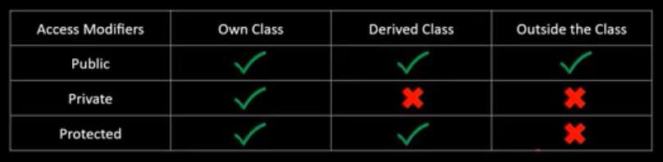
10
Access Modifiers :-
Public
Private
Protected
How Encapsulation is achieved ?

Slide 11
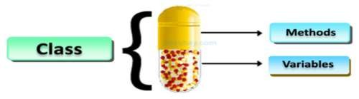
11
How Encapsulation is achieved in a class ?
Make all the data members private.
Create public setter and getter functions for each data member in such a way that the set function set the value of data member and get function get the value of data member.

Slide 12
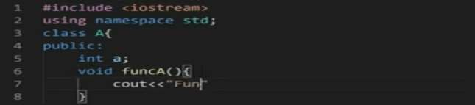
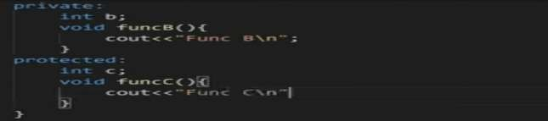
12

Slide 13

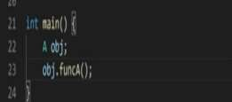
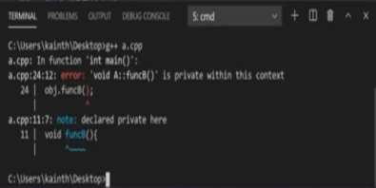
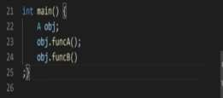
13

Slide 14
Advantage of Encapsulation in C++
14
The main advantage of using of encapsulation is to secure the data from other methods, when we make a data private then these data only use within the class, but these data not accessible outside the class.
The major benefit of data encapsulation is the security of the data. It protects the data from unauthorized users that we inferred from the above stated real-real problem.
Encapsulation is also useful in hiding the data(instance variables) of a class from an illegal direct access.
Dis-Advantage of Encapsulation in C++
You can't access private data outside the class ..

Slide 15
3.
Abstraction

Slide 16
16
Using simple things to represent complexity
Hide complex details from user
Abstraction is using simple classes to represent complexity.
Abstraction is an extension of encapsulation. For example, you don’t have to know all the details of how the engine works to drive a car.
Abstraction

Slide 17
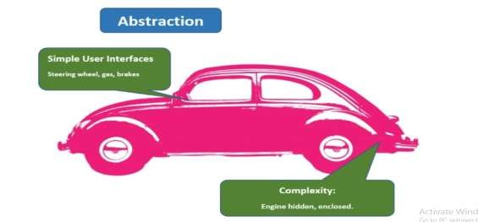
17
Lets consider this example for understanding Abstraction

Slide 18
18
A driver only uses a small selection of tools: like gas pedal, brake, steering wheel, blinker. The engineering is hidden from the driver. To make a car work, a lot of pieces have to work under the hood, but exposing that information to the driver would be a dangerous distraction.
Abstraction also serves an important security role. By only displaying selected pieces of data, and only allowing data to be accessed
through classes and modified through methods, we protect the data from exposure. To continue with the car example, you wouldn’t want an open gas tank while driving a car.
Abstraction

Slide 19
19
The benefits of abstraction are summarized below
Simple, high level user interfaces
Complex code is hidden
Security
Easier software maintenance
Code updates rarely change abstraction

Slide 20
4.
Inheritance

Slide 21
What is Inheritance?
Inheritance is a mechanism in which one class acquires the property of another class.
Reusability is an important concept of OOPs.
Boost the Maintainablity of the code.
The class from which the new class inherits properties is called BASE CLASS and the new created class is called DERIVED CLASS.
Syntax - class derived-class: access-specifier base-class
{
// data members and member functions of derived class
}

Slide 22
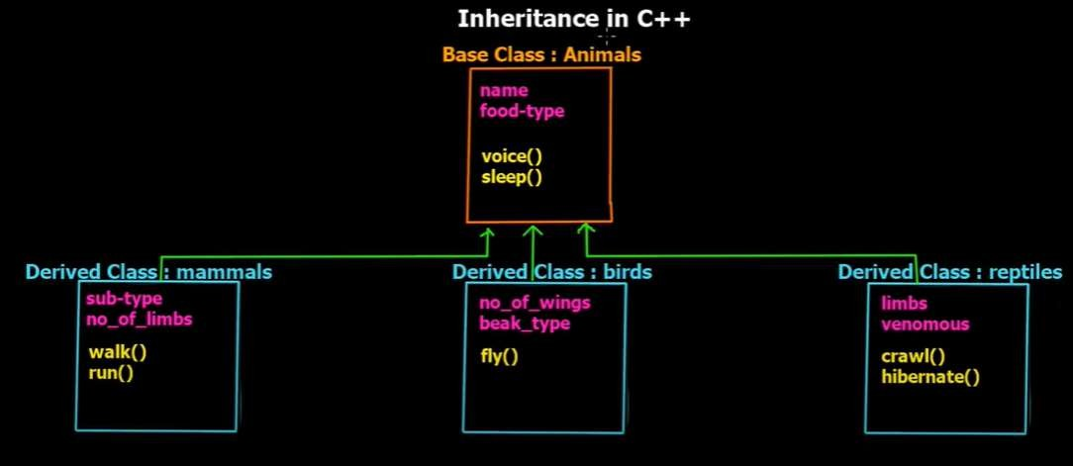
22

Slide 23
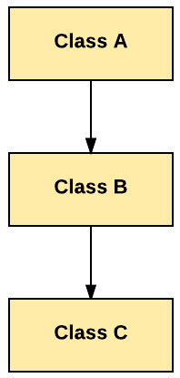
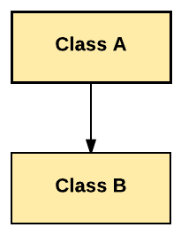
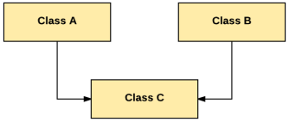
Types of Inheritance
23
Single Inheritance
Multiple Inheritance
Multilevel Inheritance

Slide 24
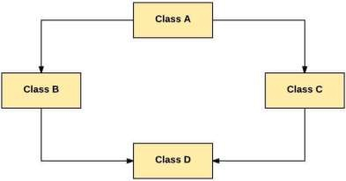
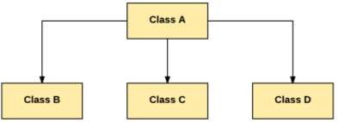
24
Hierarchical Inheritance
Hybrid Inheritance

Slide 25
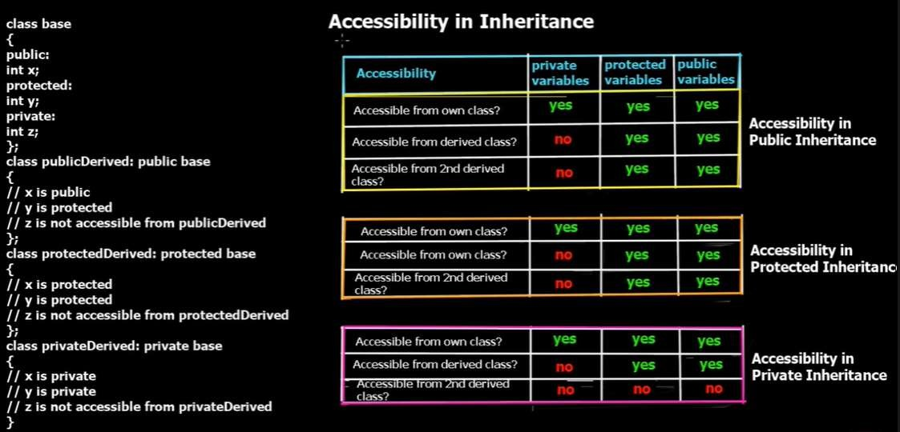
25

Slide 26
5.
Polymorphism

Slide 27
27
Polymorphism means "the condition of occurring in several different forms." That's exactly what the fourth and final pillar is concerned with – types in the same inheritance chains being able to do different things.
The word polymorphism means having many forms. In simple words, we can define polymorphism as the ability of a message to be displayed in more than one form.
Definition
Polymorphism is considered as one of the important features of Object Oriented Programming.

Slide 28
In C++
polymorphism is mainly divided into two types
28
Compile time
polymorphism:
This type of polymorphism is achieved by function overloading or operator overloading.
Function
Overloading:
Function overloading is a feature in C++ where two or more functions can have the same name but different parameters.

Slide 29
#include<iostream> #include<stdio.h> int area(int, int); float area(int);
int l,b,a;
std::cout<<"Enter length and breadth of rectangle"; std::cin>>l>>b;
29
int main()
{
int r;
std::cout<<"Enter radius of a
circle";
std::cin>>r; float A=area(r);
std::cout<<"Area of Circle is "<<A;
a=area(l,b);
std::cout<<"area of Rectangle is"<<a;
}
float area(int R)
{
return(3.14*R*R);
}
int area(int L,int B)
{
return(L*B);
}

Slide 30
Operator
Overloading
30
In C++, we can make operators to work for user defined classes. This means C++ has the ability to provide the operators with a special meaning for a data type, this ability is known as operator overloading.
For example, we can overload an operator ‘+’ in a class like String so that we can concatenate two strings by just using

Slide 31
#include<iostream> class Complex
{
std::cout<<"\na="<<a<<"\nb="<<b;
}
{ Complex temp; temp.a=a+c.a; temp.b=b+c.b;
31
{
private:
int a,b;
public:
void setData(int x, int y)
{
a=x; b=y;
}
void showData()
Complex operator +(Complex c)
return(temp); }
int main()
{ Complex c1,c2,c3;
c1.setData(3,4);
c2.setData(5,6); c3=c1+c2; c3.showData();
}
};

Slide 32
Runtime
polymorphism
32
This type of polymorphism is achieved
by Function Overriding.
A virtual function is a member function which is declared in the base class using the keyword virtual and is re-defined (Overriden) by the derived class.

Slide 33

#include <iostream> using namespace std;
// Base class class Shape
cout << "This is call to parent class area" << endl;
}
protected:
int length, width;
};
// Derived class
class Square : public Shape
{
public:
Square(int l = 0, int w = 0)
: Shape(l, w)
{
} // declaring and initializing derived class
// constructor
33
{
public:
Shape(int l, int w)
{
length = l; width = w;
} // default constructor
int get_Area()
{

Slide 34
int get_Area()
// constructor int get_Area()
{
cout << "Rectangle area: " <<
length * width<< endl;
return (length * width);
}
};
int main(void)
34
{ cout << "Square area: " << length * width << endl;
return (length * width);
}
};
// Derived class
class Rectangle : public Shape
{ public:
Rectangle(int l = 0, int w
= 0)
: Shape(l, w)
{
} // declaring and initializing derived class
{
Shape* s;
Square sq(5, 5); // making object
of child class Sqaure
Rectangle rec(4, 5); // making
object of child class Rectangle
s = &sq;
s->get_Area(); s = &rec;
s->get_Area();
return 0;
}

Slide 35
35
Object-Oriented Programming has many advantages to Procedural Programming.
In OOP, data can be made private to a class such that only member functions of the class can access the data.
The objects are processed by their member data and functions.
CONCLUSION

Slide 36
RESOURCES
36
https://www.linkedin.com/pulse/4-pillars-object-oriented-programming-pushkar-kumar
https://info.keylimeinteractive.com/the-four-pillars-of-object-oriented-programming
https://www.tutorialspoint.com/cplusplus/cpp_polymorphism.htm
https://www.guru99.com/java-class-inheritance.html#6
https://www.javatpoint.com/cpp-polymorphism
https://www.geeksforgeeks.org/encapsulation-in-c/
https://www.youtube.com/watch?v=a8ZB-TPB6EU

Slide 37
Thanks!
37

